Slide 1

Design and Analysis of Algorithms
Dinesh Singh
Department of Computer Science & Engineering

Slide 2

DESIGN AND ANALYSIS OF ALGORITHMS
Horspool’s Algorithm
Dinesh Singh
Department of Computer Science & Engineering

Slide 3
Design and Analysis of Algorithms
Horspool’s Algorithm
String Matching Problem
Find occurrences of a pattern of length m in a text of length n.
Pattern: sequence of m characters.
Text: sequence of n characters
Brute-Force String Matching
Matches characters of the pattern with the text sequentially.
Pattern shifts one position to the right after each trial.
Worst case comparisons: ϴ(nm).

Slide 4
Design and Analysis of Algorithms
Horspool’s Algorithm
Input Enhancement in String Matching
Preprocess the pattern to build useful information.
This preprocessing helps skip unnecessary comparisons during matching.
Two well-known algorithms:
    Boyer–Moore Algorithm
    Knuth–Morris–Pratt (KMP) Algorithm
KMP compares characters from left to right.
Boyer–Moore compares characters from right to left.

Slide 5
Design and Analysis of Algorithms
Horspool’s Algorithm
Horspool Algorithm
A simplified version of Boyer–Moore.
Proposed by R.N. Horspool.
Simpler implementation and efficient for many practical cases
Idea of Horspool Algorithm
Compares characters from right to left.
If mismatch occurs, pattern is shifted using a pre computed shift table.
Allows larger jumps than brute-force matching

Slide 6
Design and Analysis of Algorithms
Horspool’s Algorithm
Given a pattern P of length m and a text T of length n, It is required to check if the pattern exists in the text.
Consider as an example, searching for the pattern BARBER in some text
s₀…………………..c……………………… s_{n-1}
BARBER
Starting with last character R of the pattern, keep comparing each pair of characters in pattern and text. If all the characters match, then pattern is found. If any mismatch occurs, the pattern is shifted to the right.

Slide 7
Design and Analysis of Algorithms
Horspool’s Algorithm
The number of characters to be shifted depends on following possibilities.
‘c’ is the character of the text that is aligned with the last character of the pattern
Case 1 : Character Not in Pattern
If there are no c’s in the pattern and it is not the last character of the pattern, shift pattern by its entire length. ( c is ‘S’ here)
For example, s₀, - - - - - - - - S - - - - - - - - - - - - - - s_{n-1}
≠
BARBER
BARBER
Here, S ≠ R and also S is not present in the pattern. So, shift pattern by its length

Slide 8
Design and Analysis of Algorithms
Horspool Algorithm
Case 2. Character Occurs in Pattern
If there are occurrences of character c in pattern, but it is not last character of the pattern, then shift should align the rightmost occurrence of c in the pattern with the c in text. ( c is ‘B’ here)
For example,
s₀, - - - - - - - - - - - - B - - - - - - - - - - - - - - - - - - s_{n-1}
≠
BARBER
BARBER

Slide 9
Design and Analysis of Algorithms
Horspool’s Algorithm
Case 3. Character Only at Last Position
If c is the last character in the pattern, but there are no c’s among other m-1 characters, shift pattern by its entire length.
( c is ‘R’). Shift same as in case 1.
For example,
s₀ - - - - - - - - - - M E R - - - - - - - - - - -- - - - - - - s_{n-1}
≠ = =
L E A D E R
L E A D E R

Slide 10
Design and Analysis of Algorithms
Horspool’s Algorithm
Case 4. Character Appears Multiple Times
If c is the last character in pattern, and also there are some other c’s in the pattern, then shift will be same as in case 2. (shift should align the rightmost occurrence of c in the pattern with the c in text.)
For example,
s₀- - - - - - - - - - P R - -- - - - - - - - - - - s_{n-1}
≠ =
B A R B E R
B A R B E R

Slide 11
Design and Analysis of Algorithms
Horspool’s Algorithm
Computing the shift value
Using the summary of the four cases, the shift value of character c is computed as
Length of the pattern m if c is not among m-1 characters of the pattern (case 1 and case 3)
Distance from the rightmost c among m-1 characters in the pattern to the last character ( case 2 and case 4)

Slide 12
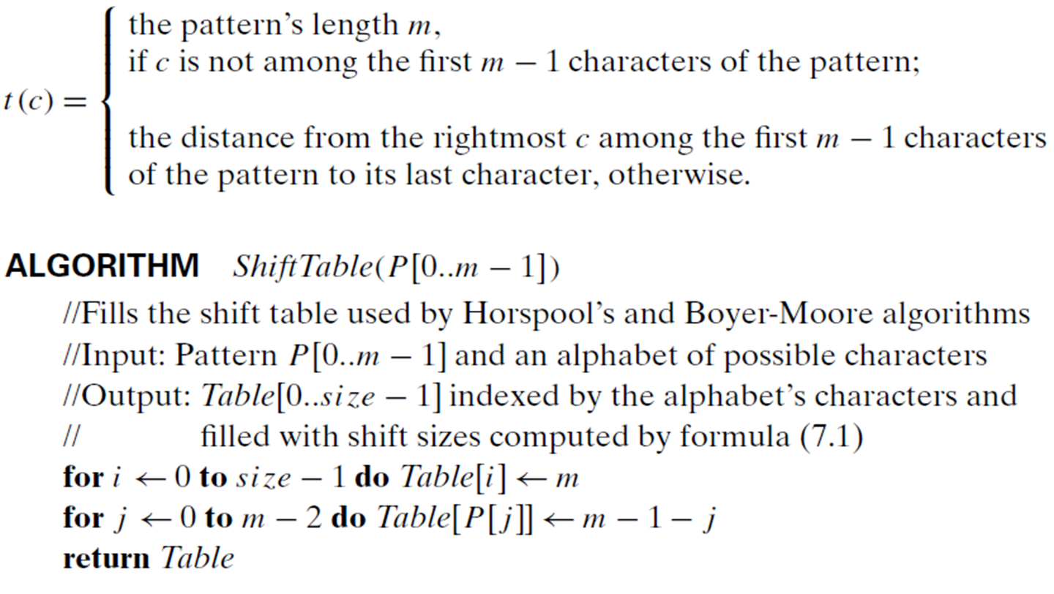
Design and Analysis of Algorithms
Horspool’s Algorithm
Computing the shift value
Algorithm to Construct the shift Table.
Pre-compute the shift sizes and store them in a table. The shift table will be indexed by all possible characters that can be encountered in text. The table entries will be filled with shift values. The shift values are computed as follows

Slide 13
Design and Analysis of Algorithms
Horspool’s Algorithm
Step 1. For a given pattern of length m and the alphabet used in both the pattern and text, construct the shift table.
Step 2. Align the pattern against the beginning of the text.
Step 3. Repeat the following until either a matching substring is found or the pattern reaches beyond the last character of the text.
Starting with the last character in the pattern, compare the corresponding characters in the pattern and text until either all m characters are matched or a mismatching pair is encountered.
In the latter case, retrieve the entry t(c) from the c’s column of the shift table where c is the text’s character currently aligned against the last character of the pattern, and shift the pattern by t(c) characters to the right along the text.

Slide 14
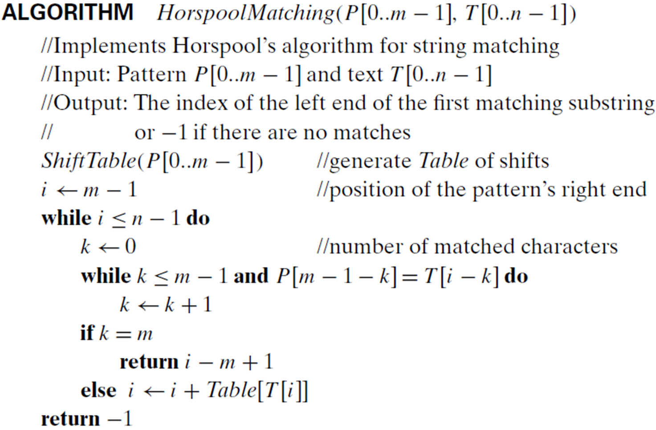
Design and Analysis of Algorithms
Horspool’s Algorithm

Slide 15
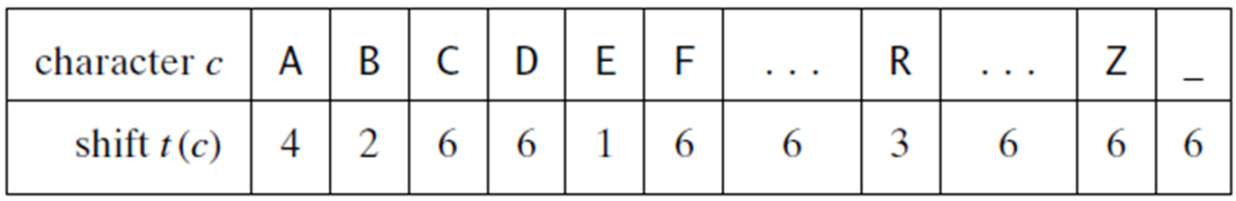
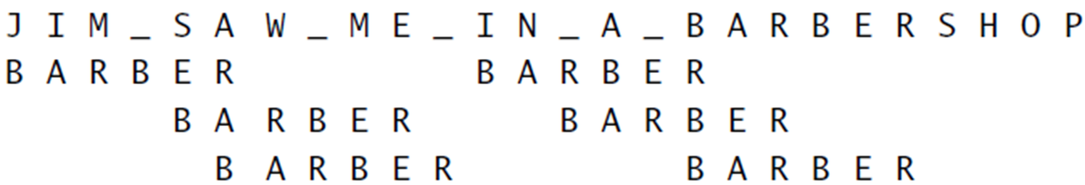
Design and Analysis of Algorithms
Horspool’s Algorithm
Consider an example of searching a pattern BARBER in the text –
JIM_SAW_ME_IN_A_BARBER_SHOP
The text consists of the alphabets A to Z and a character _.
Following is the shift Table

Slide 16
Design and Analysis of Algorithms
Horspool’s Algorithm
Efficiency
Worst-Case Efficiency
The worst-case running time of Horspool’s algorithm is ϴ(nm)
Where:
  n = length of the text
  m = length of the pattern
This occurs when the algorithm makes many small shifts and compares most characters repeatedly.

Slide 17
Design and Analysis of Algorithms
Horspool’s Algorithm
Efficiency
Average-Case Efficiency
For random texts, the running time is Θ(n).
The algorithm typically skips several characters using the shift table, reducing unnecessary comparisons

Slide 18
Design and Analysis of Algorithms
Horspool’s Algorithm
Efficiency
Comparison with Other Algorithms
Although in the same complexity class as the Brute-Force algorithm, Horspool’s algorithm is much faster in practice.
It is often as efficient as the Boyer–Moore algorithm, which is more sophisticated but computationally heavier.

Slide 19
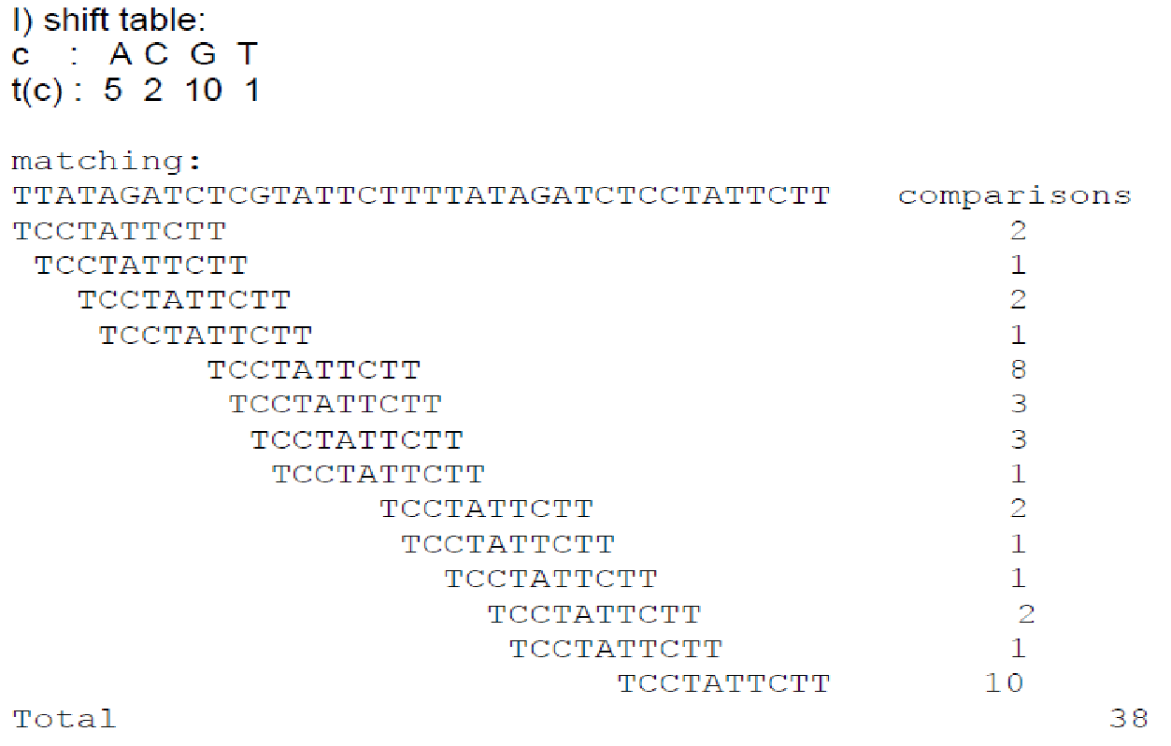
Design and Analysis of Algorithms
Horspool’s Algorithm
Construct the shift table for the pattern TCCTATTCTT ii) show matching of this pattern on text TTATAGATCTCGTATTCTTTTATAGATCTCCTATTCTT using Horspool algorithm. Iii) count the number of comparisons

Slide 20
Design and Analysis of Algorithms
Horspool’s Algorithm
Trace the Horspool algorithm to find the pattern “ELECTION” in the text “EDUCATION_ONLY_HELPS_IN_SELECTION”

Slide 21
Design and Analysis of Algorithms
Multiple choice Questions
In Horspool’s algorithm, the shift value for a character c of the text not appearing among the first m−1 characters of the pattern is:
m−1
m
1
0
Answer: A. m

Slide 22
Design and Analysis of Algorithms
Multiple choice Questions
In Horspool’s algorithm, pattern characters are compared with text characters:
A. From left to right
B. From the middle outward
C. From right to left
D. Randomly depending on mismatch
Answer : A. From right to left

Slide 23
Design and Analysis of Algorithms
Multiple choice Questions
Suppose the pattern is ABRACADABRA (length of pattern =11).
What is the shift value for character A in the shift table?
3
5
8
10
Answer : A. 3

Slide 24
Design and Analysis of Algorithms
Multiple choice Questions
Which of the following best explains why Horspool’s algorithm often performs better than brute-force string matching?
It reduces the number of comparisons by skipping characters using shift tables
It compares characters from both ends simultaneously
It sorts the pattern before matching
It avoids preprocessing completely
Answer : A. It reduces the number of comparisons by skipping characters using shift tables

Slide 25
Design and Analysis of Algorithms
Multiple choice Questions
For a pattern of length m, the preprocessing step for constructing Horspool’s shift table takes:
ϴ(1)
ϴ(m)
ϴ(n)
ϴ(mn)
Answer : B. ϴ(m)

Slide 26
THANK YOU
Dinesh Singh
Department of Computer Science & Engineering

